Slide 1
Topics of this course
What is CS
Lect1: What is computer
Lect2: How is computer system working
Why is CS so hot
Where is CS being applied to
How to learn CS

Slide 2
Lecture 2: how is computer system working
Qiang Lyu, qiang@suda.edu.cn
Soochow University

Slide 3
Remind: what is a computer (physically)?
A machine
An auto machine
An auto machine which can do very very fast calculations.
Fast enough that calculations have evolved to omnipotence!
Programmable
Memorable
Configurable

Slide 4
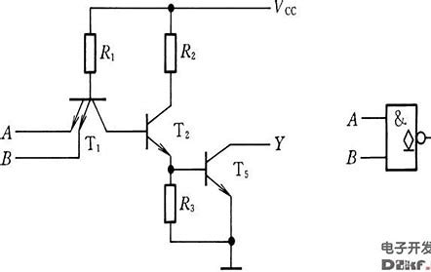
How computer exactly does calculation?
Boolean algebra: theoretical guarantee
Combinations of elemental gates can do every calculation
Digital circuit: physical implementation
NAND gate

Slide 5
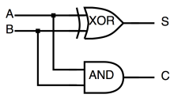
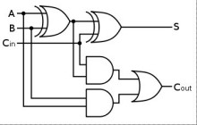
Binary system
Simplest representation!
But with longest string
Simplest unit calculation!
1-bit half adder: 4 rows each with 2-input and (1+1)-output
1-bit full adder: 8 rows each with (2+1)-input and (1+1)-output

Slide 6
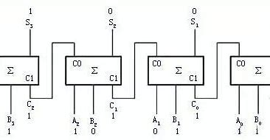
CPU is good at fast repeating simplest unit calculations: N-bit adder
64-bit cpu

Slide 7
So far by now, what can CPU do in very fast speed:
N-bit adder
N-bit logical operations
By carefully intentional design of binary numbering system, CPU can do:
Float adder
Using adder to do minus operation
……
By introducing extra circuits to do necessary other operations
CISC: extend complex operations as need (Intel)
RISC: keep minimum such operations (ARM)

Slide 8
How to drive computer for solving a problem: programming
Program: a sequence of instructions
Low level: machine understandable
Middle level: abstracting low level for human easier usage
High level: human-oriented
Compiler transfers high level languages to low level
Programming: human write orders for computer execution

Slide 9
Programming language
Machine language
Assembly language
Fortran, C
Pascal, Basic,
C++, Java,
Python, GO,
low
level
compiling
high

Slide 10
Program: circle of life
Program: operations on data with I/O
Program itself is taken as a special kind of ‘data’, stored on where regular data are stored
CPU loads program one instruction by one from memory, executes the sequence of instructions

Slide 11
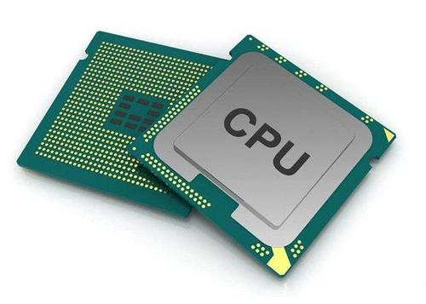
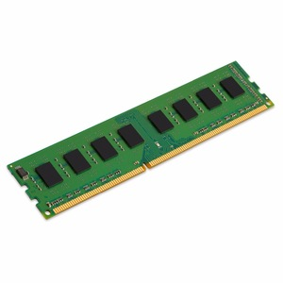
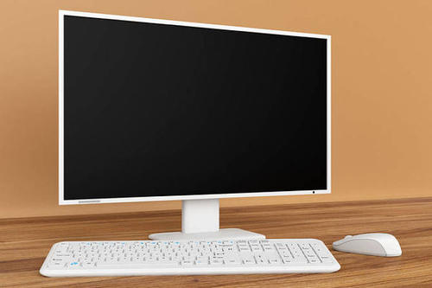
Basic devices which a program must go through
Recall Von Neumann Architecture：CPU+Memory+I/O
3. out 1, [SI]
1. Print(‘Hello,world!’)
2. out 1,[SI]
…
72,108,108,…
4.Hello,world!
Working space
Living space
Inputting/Outputting space

Slide 12
What is software exactly?
Program +
Algorithm +
Protocol +
Document +
Data (when running)

Slide 13
What is algorithm?
“A finite set of rules that gives a sequence of operations for solving a specific type of problem.” -- Knuth 3rded, 1998
Not too long
Step by step
Not for too general problems
Not for a single problem

Slide 14
What is algorithm: important features
Input
Output
Finiteness
Definiteness
Effectiveness

Slide 15
CS and algorithm
One important part of CS is about art of algorithms
The art of computer programming -- Knuth’s famous book title
Design elegant algorithms
Make them run efficiently and fast on computer

Slide 16
Software vs hardware
All kinds of programs are called Softwares
Comparatively, all devices for programs execution are called Hardwares
Without hardware, software shows nothing
Without software, computer can do nothing
What are CS folks doing: design good software running on good computer for easy usage to end-users

Slide 17
Software category
System software: for developers
Operating system
Developer tools (platform/environment)
Utilities
3-rd party libraries
Application software: for end-users targeting on specific problem

Slide 18
Operating system: the most important system software
Windows, MacOS, Linux-based distributions, Android, IOS, HarmoneyOS
Manage CPU, Memory and most importantly I/O devices for programs running

Slide 19
Android vs HarmoneyOS (HOS)
Android is a title of commercial software sets released by Google:
AOSP (linux-kernel) + GMS (remember 3-rd party libraries?)
GMS is NOT open-source
There are valuable apps based on GMS
Google has rights to restrict GMS, but AOSP is definitely open.
SmartPhone manufactures wrap up Android with their own UIs.
HarmoneyOS is a framework released by Huawei for dealing with the restriction GMS from Google:
AOSP + LiteOS + HMS
AOSP is necessary in case of AOSP-based apps are required to run on HOS
GMS-based apps can not be run on HOS

Slide 20






The biggest valuable contribution of HOS (liteOS-based part)
IOS, Android vs HOS (micro-kernel architecture)
One as all. All as one.
Apps
Apps
LiteOS
optional
Server
as need
Server
as need
LiteOS
}
OS
hardware
hardware
hardware
App
App
servers

Slide 21
The shortages of HOS (liteOS-based part)
Drivers adapters to various I/O devices
IoT involves:
Stable networking
Adapters to network
Proper delivery of the processing power among the Things: architecture

Slide 22
Eco system of IT: different scopes
Software & hardware
Apple
Software:
OS -> developing Env -> apps -> marketing -> end-users -> money Back Propagation
Hardware:
CPU -> communicating -> multimedia -> memory -> terminal manufactures -> marketing -> end-users -> money Back Propagation

Slide 23
Software vs hardware
All kinds of programs are called Softwares
Comparatively, all devices for programs execution are called Hardwares
Without hardware, software P/I/O nothing
Without software, computer can do nothing meaningful
What are CS folks doing: design good software running on good computer for easy usage to end-users

Slide 24
Key ideas of this lecture
Human programs to drive chips responding

Slide 25
Homework 2
Is Weixin an application or a system software?
How about Weixin applet(微信小程序)?
Why?

